Slide 1
TEMPLATES

Slide 2
Template
Template concept can be applied to functions as well as classes
  Template functions
  Template Classes

Slide 3
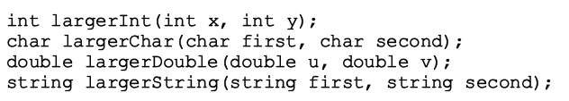
Template Functions
Templates allows programmers to write a SINGLE functions for a set of related functions
Lets take an example

Slide 5
Template Function
A template function will always start with a line as:
template <class Type>
OR
template <typename Type>
keyword class or typename can be used interchangeably

Slide 6
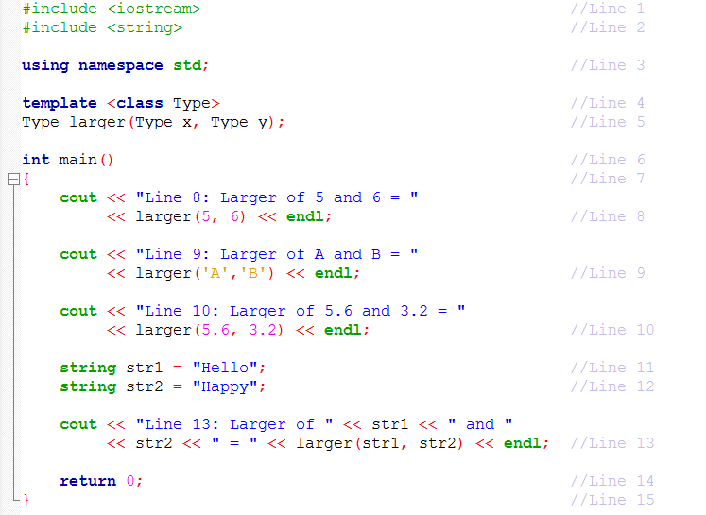
Example 2.7

Slide 7
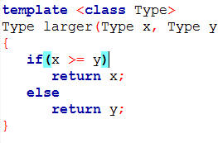
Example 2.7

